Slide 1
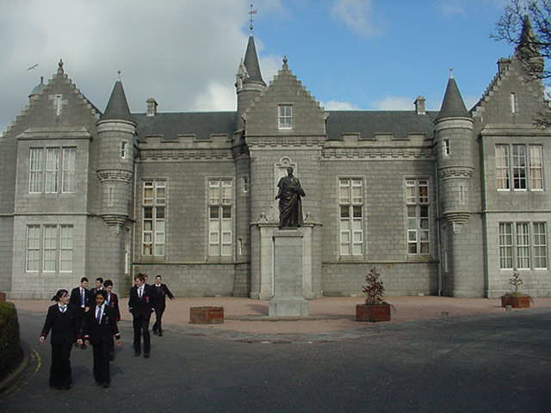

Aberdeen Grammar School
S3 into S4
Parents’ Information Evening
January 2017

Slide 2
  Ms Alison Murison
  Head Teacher

Slide 3
The Senior Phase
All pupils in S4, S5, S6 are in the Senior Phase
A wide range of courses available
National 3, 4, 5
Higher
Advanced Higher
As pupils progress from S4 to S5 to S6 they add to their “basket of qualifications”

Slide 4
Course Structure
Courses are designed by Scottish Qualifications Authority
Each course designed around 140 hours of study
Courses divided into 3 units of time

Slide 5
Assessment of National 3 and 4
Unit assessment - each school sets the assessment based on SQA guidance
- pass or fail, not graded
Value added unit - assess ability to use and apply skills and knowledge
All assessment at National 3 and 4 is done in school
There is NO external exam set and marked by SQA
SQA verifies the standard of each school
Pass or fail, not graded

Slide 6
Assessment of National 5
End of course assessment / examination
- set and marked by SQA
- examinations in May/ June
- grade A, B, C, D or no award

Slide 7
  Mr Alan Martin
  Depute Head Teacher

Slide 8
S4 Curriculum
All pupils will study
  Physical Education, 2 periods
  Social Education, 1 period
  Religious and Moral Education, 1 period
  English, 5 periods
  Mathematics, 5 periods
  4 subjects, for 4 periods each
6 qualification courses in total

Slide 9
National 4, National 5 Courses
a wide range of courses on offer to all S4, S5, S6
pupils from all 3 year groups could be in the same class
Administration Art & Design Biology Business Management Chemistry Computing Design and Manufacture Drama Engineering Science English English for Speakers of other Languages French | Geography Graphic Communication History Hospitality Practical Cookery Mathematics Modern Studies Music Musical Theatre Physical Education Physics Skills for Work College Courses Spanish

Slide 10
Where are courses taught?
Aberdeen Grammar School
North East Scotland College, Aberdeen (Skills for Work courses)
Consortium – Hazlehead, Cults, Harlaw and Northfield Academies

Slide 11
Notes:
11

Slide 12
Notes:
12

Slide 13
Shelley MacKenzie

Slide 14


Slide 15

Career Education Opportunities
“As they move into the senior phase, young people of all abilities should have the opportunity to follow industry relevant vocational pathways alongside academic studies.”
Education Working For All – June 2014

Slide 16
School College Links Courses
Young people can study a range of both school and College qualifications at the same time
Choosing a School Link course will generally require pupils to attend a College Campus which may involve independent travelling.
Young people will be well equipped for moving on to either College, University or direct to employment having developed some of the essential skills required.

Slide 17
Contact Us:
Any queries from pupils or parents can be answered in school by Guidance Staff or please email us at:
schools@nescol.ac.uk
We are also on Twitter and Facebook for regular updates!
www.facebook.com/NESColLinks
www.twitter.com/NESColLinks

Slide 18
Support for Pupils
Notes:
18

Slide 19

Senior Phase Options
English
Geography
Chemistry
Maths
Senior Phase

Slide 20
Well informed and realistic decisions
PTPS SUPPORT
Social Education
Research
Skill and strength analysis
General advice

Slide 21
Well informed and realistic decisions
PTPS SUPPORT
One to One interviews
Review and Reflect upon subject reports
and tracked data
Strongest subjects
Subjects they enjoy
Future career requirements
Realistic choices

Slide 22
Well informed and realistic decisions
RESOURCES
  Careers section in library
  Senior Phase course booklets (on school website)
  College course information booklet (on school website)
SENIOR PUPILS
Information shared during tutor time

Slide 23

Morag Evans
Careers Adviser

Slide 24
Our Service
All Age – Union St office
Face to face - Online – Facebook - Twitter
Not bound by school terms
Continuity through school and beyond
Mostly aimed at S4/5/6 in school
Individual interviews mainly agreed via PTPS
Lunchtime Clinic for all – 2nd half of lunchtime usually Mon, Tues, Wed
Just finished visiting all S3 PSE classes

Slide 25
Research
Must be done by/with pupil – choice is theirs
www.myworldofwork.co.uk
www.planitplus.net
Careers Library
Social Networking / Media
Talk to people

Slide 26
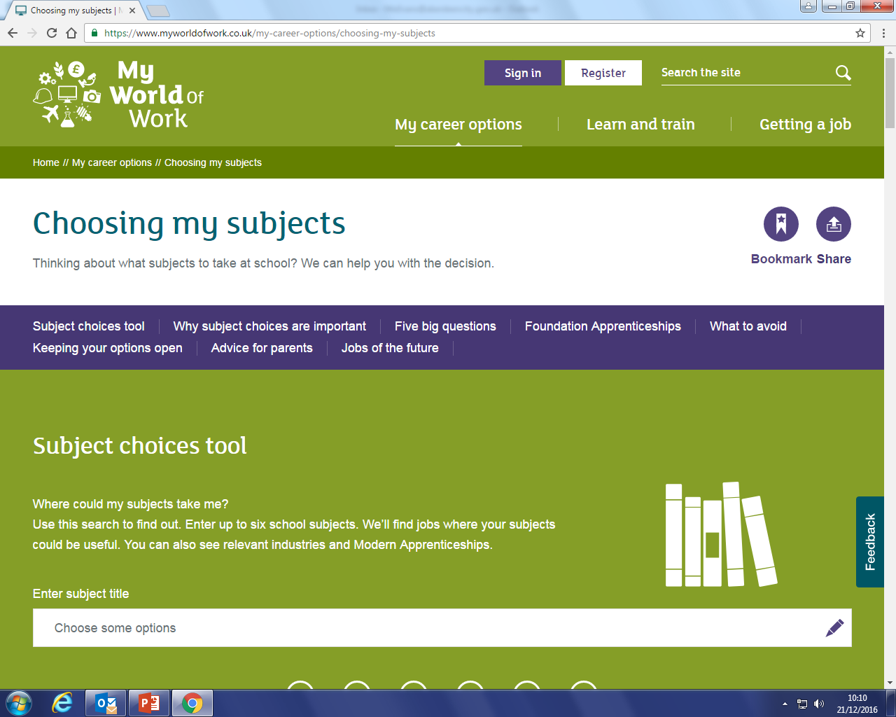

Slide 27
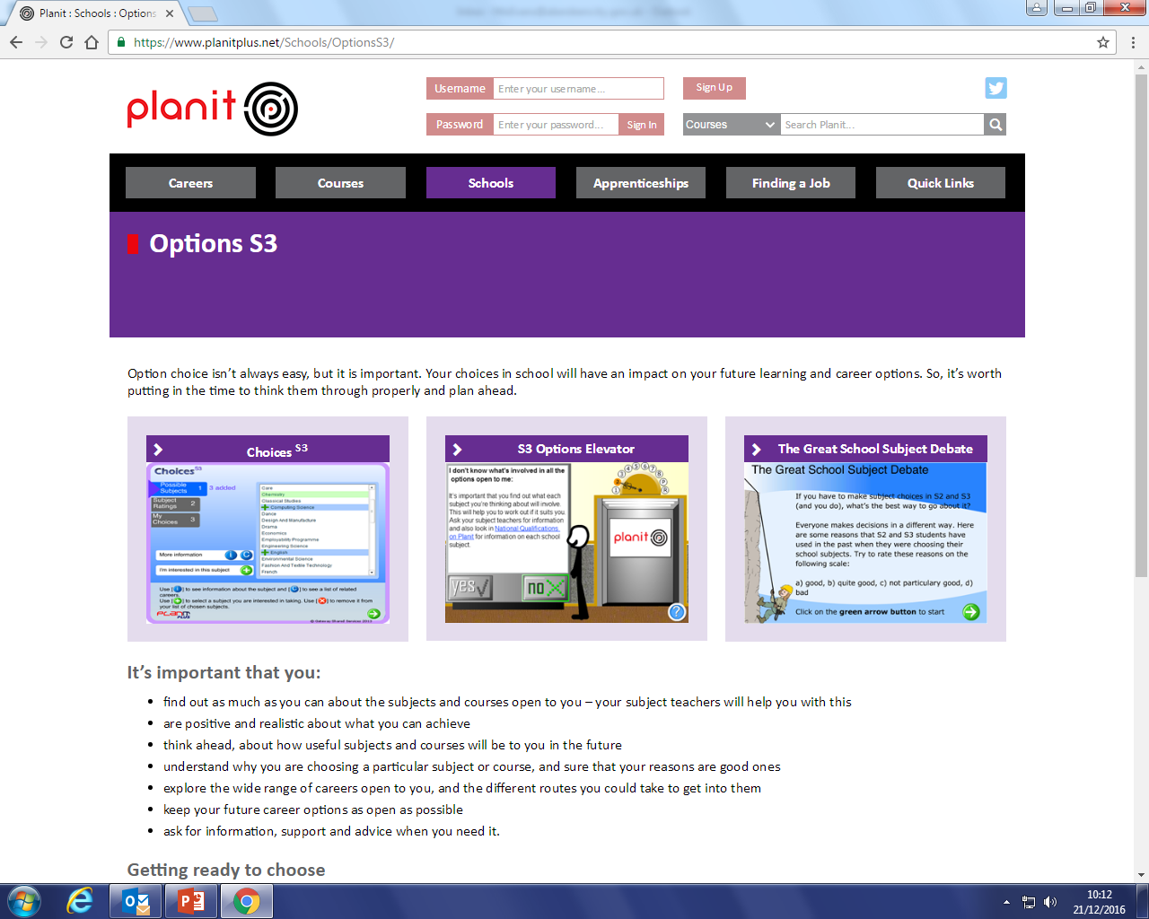

Slide 28
Work Experience
School organised experience – 1wk in May
Organise your own too – as many as you want!
In the holidays/weekends
Helps research
Sets you apart
Confidence
Something to talk about in interviews

Slide 29
Useful Websites
www.myworldofwork.co.uk – what to choose/ advice/ identify strengths
www.planitplus.net – what am I good at?
College and university websites – entrance requirements
www.ucas.com – applying to uni/ entrance requirements
www.apprenticeships.scot – MA’s
www.saas.gov.uk – funding for HE

Slide 30
Key Dates
12 January, S3 Parents’ Information Evening
December – January, preparation through Social Education
January, Shelley MacKenzie briefing on college options
January, Depute Head briefing on choice process
2 February - S3 Parents’ meetings
10 February, S3 into S4 choice forms returned

