Slide 1
STEM In BP

Slide 2
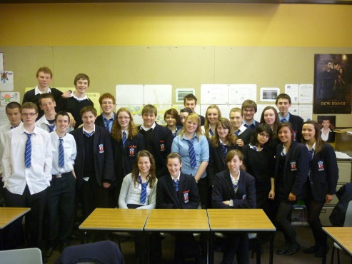
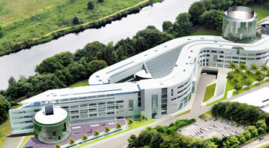
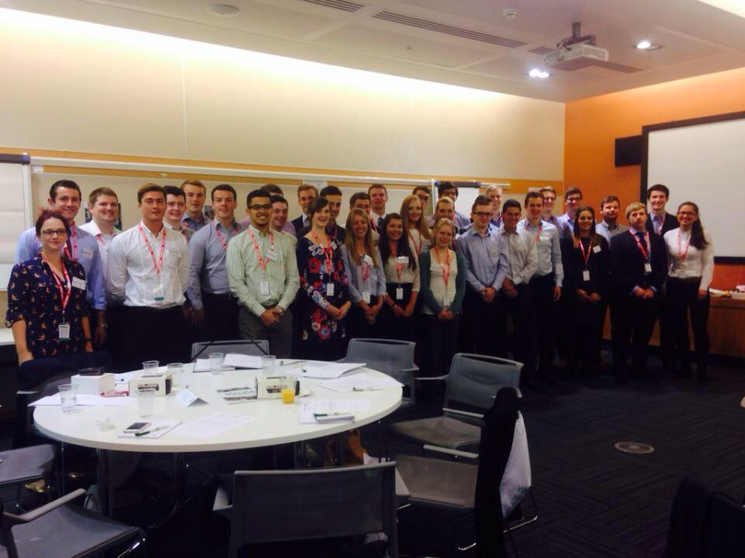
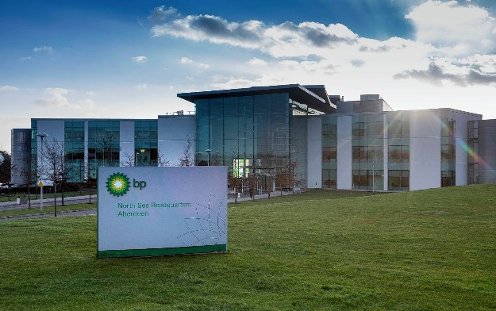
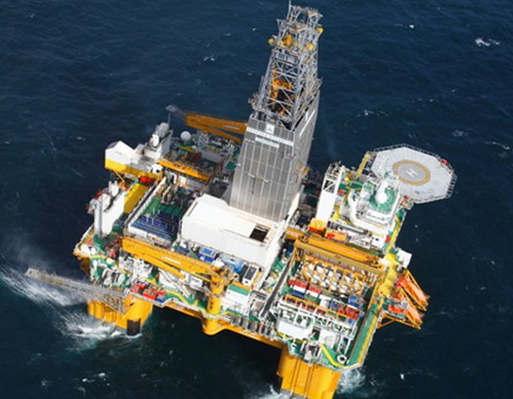
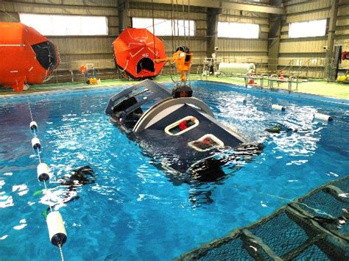
Introduction & Career Overview
Study
Aberdeen Grammar
Degree – RGU MEng Mechanical Engineering (Fast-track)
Started Graduate Job with BP - September 2015
Placements
2013 – Wells Intern – ConocoPhillips
2014 – Well Integrity Intern – BP
2015 – Subsea Wells Intern – BP
2015 – 17 Subsea Wells Projects Engineer
2017 – 18 Well Site Drilling Engineer on Deepsea Aberdeen

Slide 3
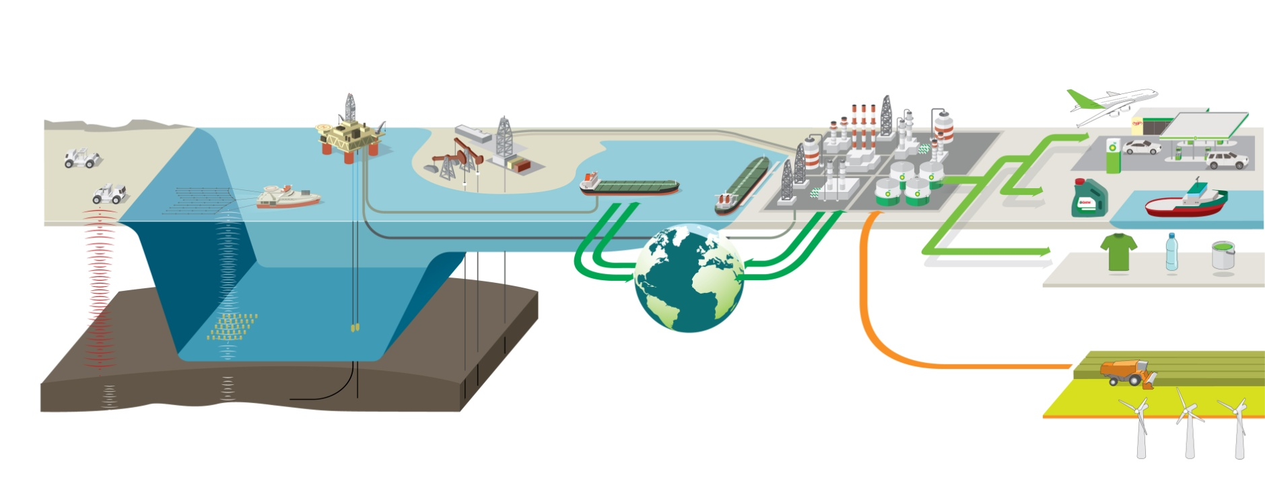
Oil and Gas business model
Finding oil and gas
Developing and
extracting oil and gas
Transporting and
trading oil and gas
Manufacturing and marketing fuels and products
BP Upstream
IST and BP Shipping
BP Downstream
(Refining -> Wholesale and retail to B2B and B2C customers)
Notes:
We’re going to run through the stages BP goes through; from finding the oil, all the way through to producing useful products. Play video!
Speaker Notes:
Source: Annual report and Form 20F 2011
Value creation in our industry BP’s core activities are similar to those carried out by other global, integrated, oil and gas companies.
First, we acquire the rights to explore for oil and gas. When we are successful in ﬁnding hydrocarbon resources, we create value by seeking to develop them into proved reserves or by selling them on if they do not ﬁt with our strategic objectives. We often work with partners to mitigate risk or gain from complementary skills. Through disciplined execution of capital projects we then develop, extract and sell the resources. The beneﬁts are shared with governments and other partners.
We move oil and gas through pipelines and by ship, truck and rail. We use our skills and knowledge to ﬁnd the best routes to deliver supplies to the most attractive markets.
We manufacture fuels and products, creating value by seeking to operate a high-quality portfolio of well-located assets safely, reliably and efﬁciently. We use our sales and marketing skills to add value to our fuels and other products.
And we also invest in renewable energy sources, with a focus on biofuels and wind.
70 different countries, 80,000 people globally

Slide 4
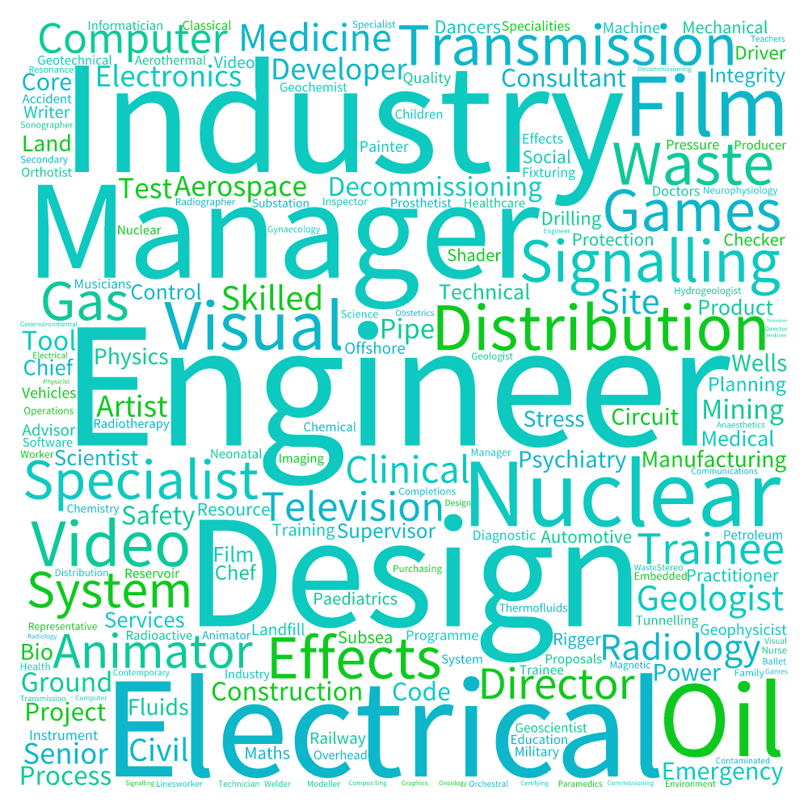



What Are STEM Careers?
UK Skills Shortage
Science Qualified Workforce
Growth areas will be:
  Low carbon economy: sustainable energy business
  Life sciences: health, pharmacy, disease prevention
  Digital media: writing, design, games
  Professional, financial and other services
  Advanced manufacturing: managing businesses
  Built environment: designing low energy buildings
  Food: improving safety, nutrition and supply
Only three non STEM related careers in UK Skills Shortage list.
185,000 graduates required annually in engineering disciplines alone!
–> 7.1 million jobs in 2030

Slide 5
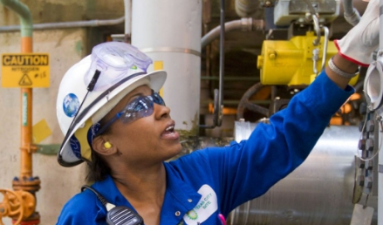
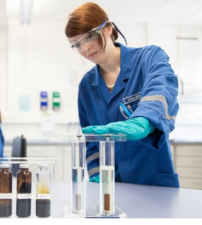

Engineering
STEM Roles in BP
Business & Trading
Trading
Technology (IT/Software Development)
Analytics
Finance/
Accounting
Commercial
Mechanical Engineering
Automotive Engineering
Chemical Engineering
Civil Engineering
Project Engineering
Electrical/
Electronic Engineering
Marine Engineering
Petroleum Engineering
Materials Engineering
Pipeline Engineering
Naval Architecture
Process Safety/Risk
Engineering
Chemistry
Environmental Science
Geoscience
Petrophysics
Science
Notes:
Pick out 1 or 2 unusual examples they may not have expected to see e.g. Automotive Engineering, Naval Architecture, Environmental Science - briefly explain how they fit into BP
Highlight the fact that BP is so large and complex, there is a huge range of opportunity within the company regardless of what they go on to study

Slide 6
Graduate/Intern Application Process
Get Involved
Techfest
STEM Events:- Maths in the Pipeline etc.
Discover BP Days
Shadow an Intern
BP Scholarships
Online Resources (Role information, videos, application details, degree matchers + more)
bp.com/ukgraduates
Take away a brochure for more information!
Notes:
NB To apply to Discovery Days or Shadow an Intern in their 1st or 2nd year it is just an application form
Graduates and Interns go through the same process:
Application form
Online tests (numerical and verbal and SJQ
Telephone interview
Technical interview (face to face unless overseas)
Assessment centre.
Candidates who are successful at the application stage will be invited to sit our online numerical and verbal tests which last 12 minutes each and are available in various languages.
Telephone interview will cover personal competencies.
Technical interviews and assessment centres are based around our graduate competency profile and will be held in the South East, London and Aberdeen depending on discipline. Accommodation may be provided for long distance candidates and reasonable travel expenses will be paid subject to receipts.
To apply to an internship, students must be in their penultimate year of study

