Slide 2


Welcome
Learner Pathways Evening
Developing the Young Workforce (DYW)

Slide 3
Purpose of the evening
Introduction – Alison Murison (Head Teacher)
CFE levels and National Qualifications – Alison Murison
Choice form process – Alan Martin (DHT curriculum)
Pupil perspective – Jonathan Bell and Holly Imperiale
Skills Development Scotland – Mrs Morag Evans
STEAM – Mr Craig Ellis (Gray’s School of Art)
STEM – Miss Geraldine Cooper

Slide 4
CfE levels and National Qualifications
In S1-S3, pupils are building their skills to
prepare for National Qualifications in S4-S6
SQA National Qualifications
Junior Phase S1-S3 | First level (1)
 | Second level (2)
 | Third level (3)
 | Fourth level (4)
National 4 (4) | Senior Phase S4-S6
National (5)
Higher (6)
Advanced Higher (7)

Slide 5
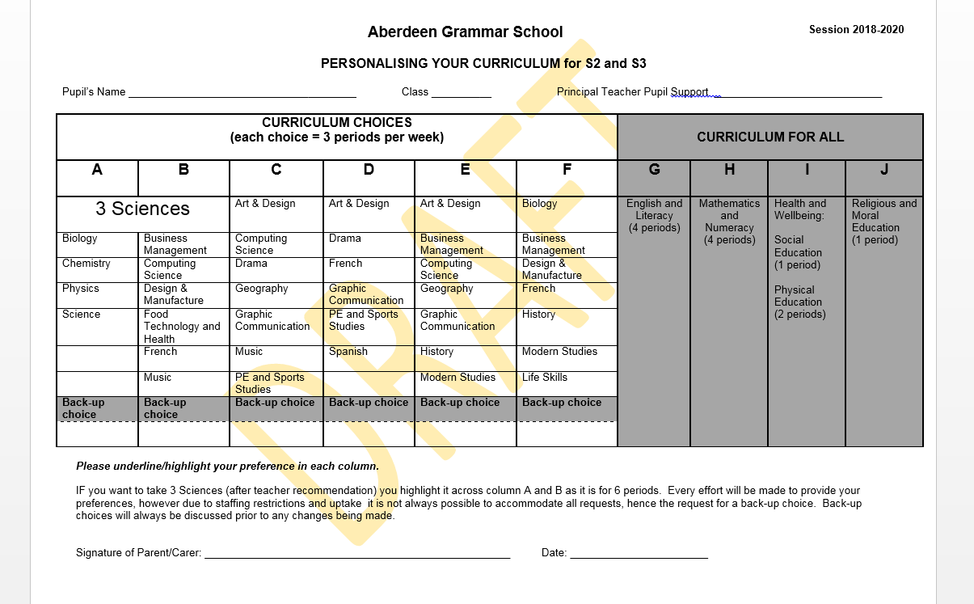
Choice Form

Slide 6
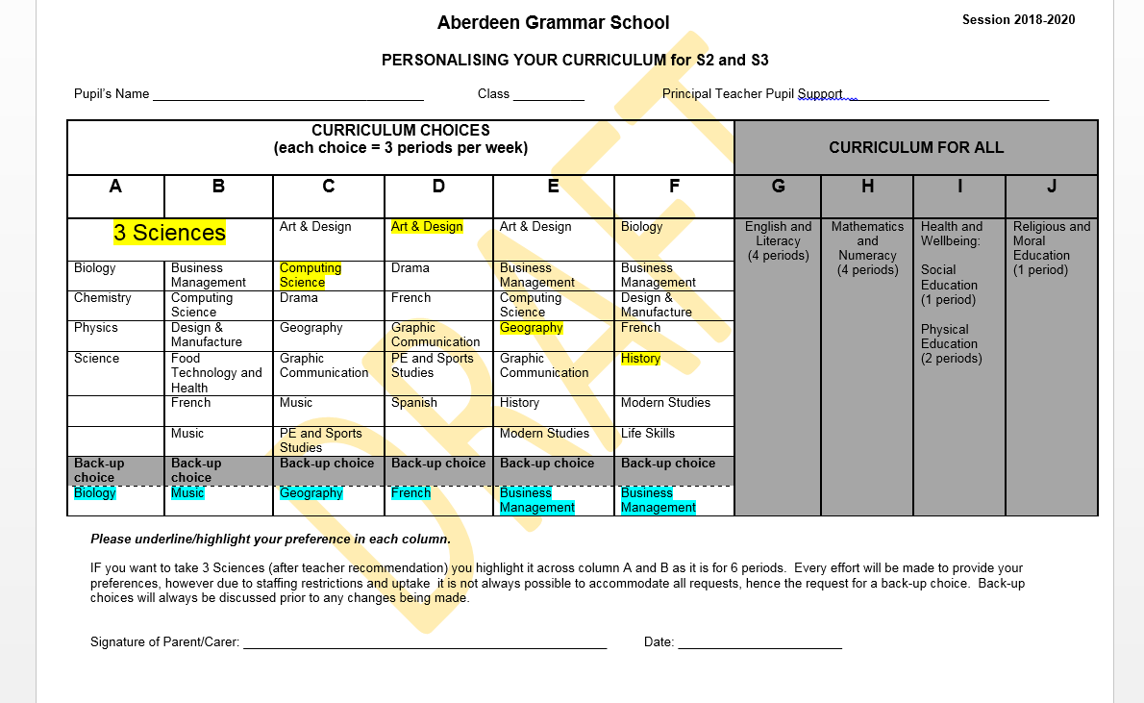
How to complete Choice Form

Slide 7
Learner Journey - Jonathan
Year | Subject
s1 | All courses
S2/3 | French | History | Maths | English | Chemistry | Biology | PESS | Geography
S4 | French | History | Maths | English | Chemistry | Biology
S5 | French | History | Maths | English |  |  |  | Accounting
S6 | French | History |  |  |  |  |  | YASS Accounting | Business Management
Future Pathway????

Slide 8
Learner Journey - Holly
Year | Subject
S1 | All courses
S2/3 | Chemistry | Maths | Physics | History | French | English | Admin | Music
S4 | Chemistry | Maths | Physics | History | French | English
S5 | Chemistry | Maths | Physics | History | French
S6 | Chemistry | Maths | Physics |  |  |  |  |  | Biology
Future Pathway????

Slide 9

Mrs Morag Evans – Skills Development Scotland
Career Management Skills – Self, Strengths, Horizons & Networks
Transferable skills/Skills sets, not just specific job titles
www.myworldofwork.co.uk www.planitplus.net
2nd ½ of lunch break Mon, Tues, Wed

Slide 10
Skills Development Scotland
https://www.youtube.com/watch?v=ITJUQre19Mg

Slide 11
Key Skills – Resilience, Entrepreneurship, Problem Solving, Creativity, Manipulating Technology
Key Sectors – Tourism, Life Sciences, Energy, Finance, Food & Drink, Creative, ICT, Health/Care

Slide 12
STEAM perspective
Mr Craig Ellis

Slide 13
STEM perspective
Miss Geraldine Cooper

Slide 14
Next Steps
Depute presentation to S1’s – Week beginning 26th February 2018
Course booklets and choice form issued
Parents night:
Thursday 15th March 2018
Choice form returned by:
Friday 23rd March 2018

