Slide 1



http://graysartschoolaberdeen.com
Craig Ellis
Associate head of Undergraduate Studies
Notes:
Routes, the interview, folio, quals

Slide 2
What is STEAM?
Notes:
RECYLCE

Slide 3
STEM
Notes:
RECYLCE

Slide 4
STE(A)M
Notes:
RECYLCE

Slide 5
STE@M
Notes:
RECYLCE

Slide 6
What is the key skill for your future employees?
Notes:
RECYLCE

Slide 7
73%
Notes:
RECYLCE

Slide 8
73% said
CREATIVITY
Notes:
RECYLCE

Slide 9
1+1= 2
Notes:
RECYLCE

Slide 10
1+1= 3
Notes:
RECYLCE

Slide 11
Where are the
Creative & Cultural
Industries?
Notes:
RECYLCE

Slide 12
Notes:
RECYLCE

Slide 13
The Creative Industries contribute £3.7bn
to the Scottish economy each year,
supporting 71,800 jobs
The Creative Industries is now larger than Life Sciences and sustainable tourism in terms of GVA and employs more people than the Energy sector.
Scottish Government Creative Industries Growth Sector Statistics, 2015

Slide 14
Craft contributes £3.4bn to the UK
economy each year. In addition to the value it creates in its own right, craft adds value to other industrial sectors, including healthcare, engineering or architecture.
Measuring the Craft Economy, 2014.

Slide 15

Notes:
Visual Arts / Participatory practice / TV / Digital technology and Gaming / Community Education / Design / Craft / Fashion / Festivals / Film / Music /
Media / Audience Development / Cultural policy / Dance / Theatre / Publishing / Museums

Slide 16
Art & Design
Where you learn how to be more Creative
Notes:
RECYLCE

Slide 17
Art & Design
Where transferable life skills are core to your study
Notes:
RECYLCE

Slide 18
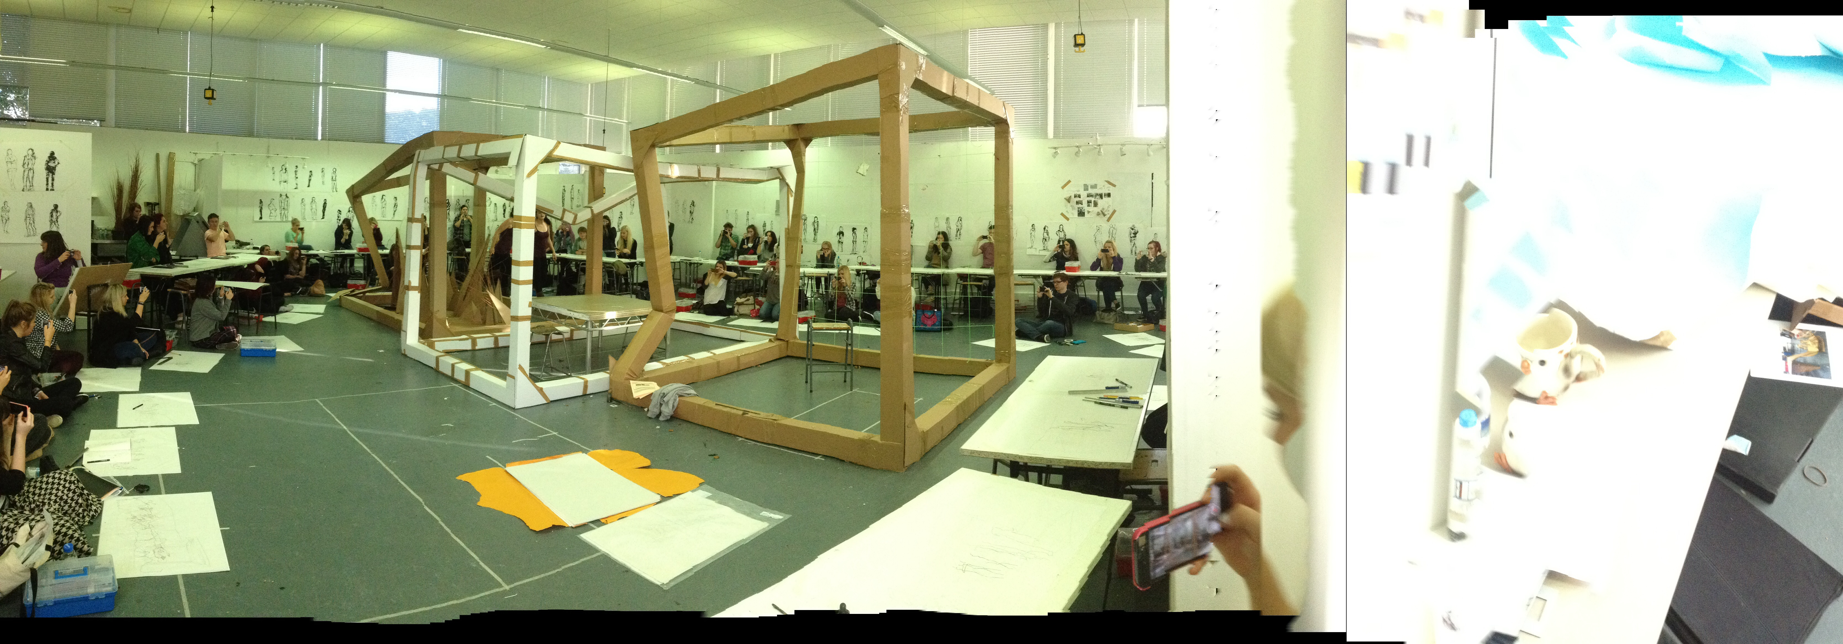
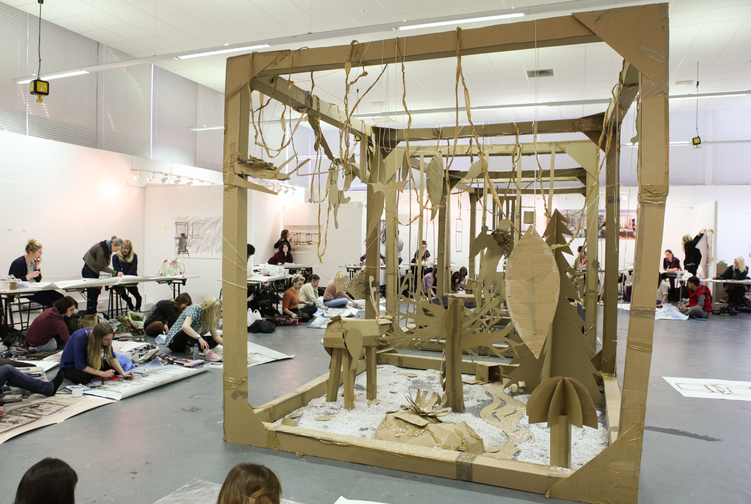
to see things differently
to find a voice
to change and evolve
to be constantly challenged and surprised
to gain an understanding of your creativity
to learn conceptual skills and their practical application

Slide 19

Art School Culture
Thinking & Making
The informed practitioner
Facilitating the future shapers
Notes:
We want you to be informed practitioners because we are.

Slide 20
Any questions?
Notes:
RECYLCE

Slide 21
Awkward silence
Notes:
RECYLCE

