Slide 1
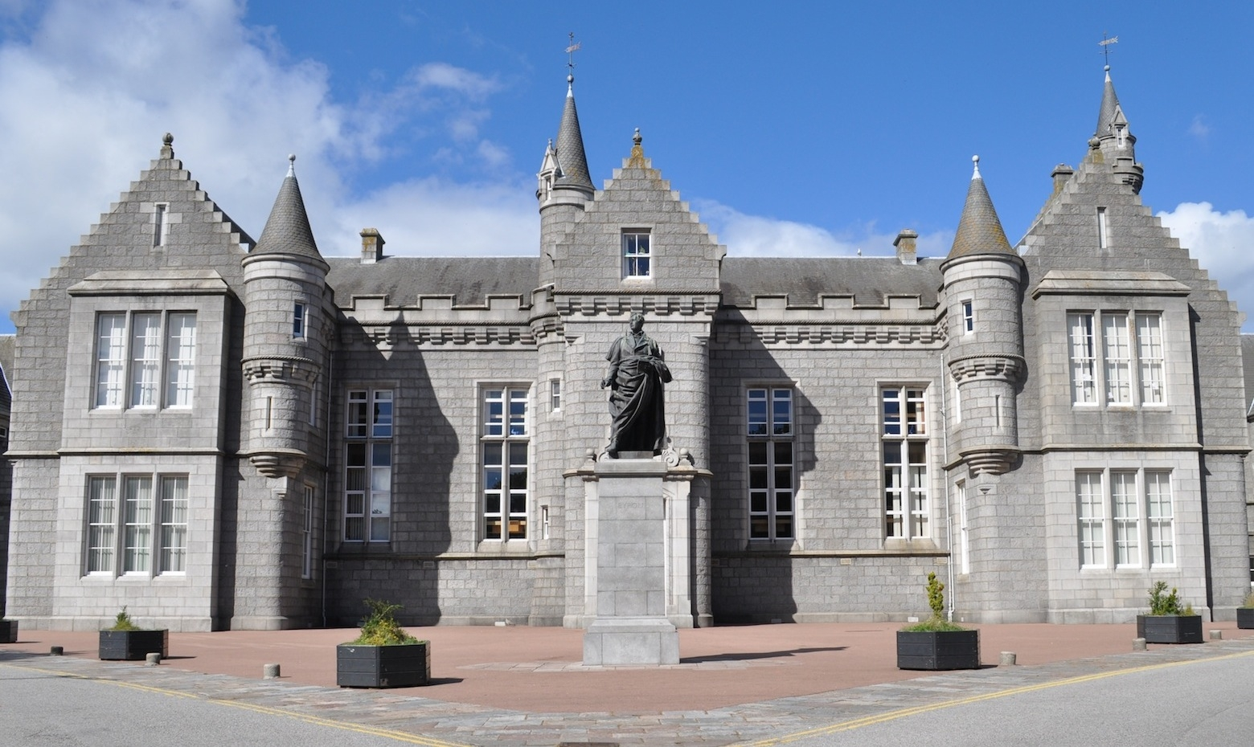
Pupil Council
Aberdeen Grammar School

Slide 2
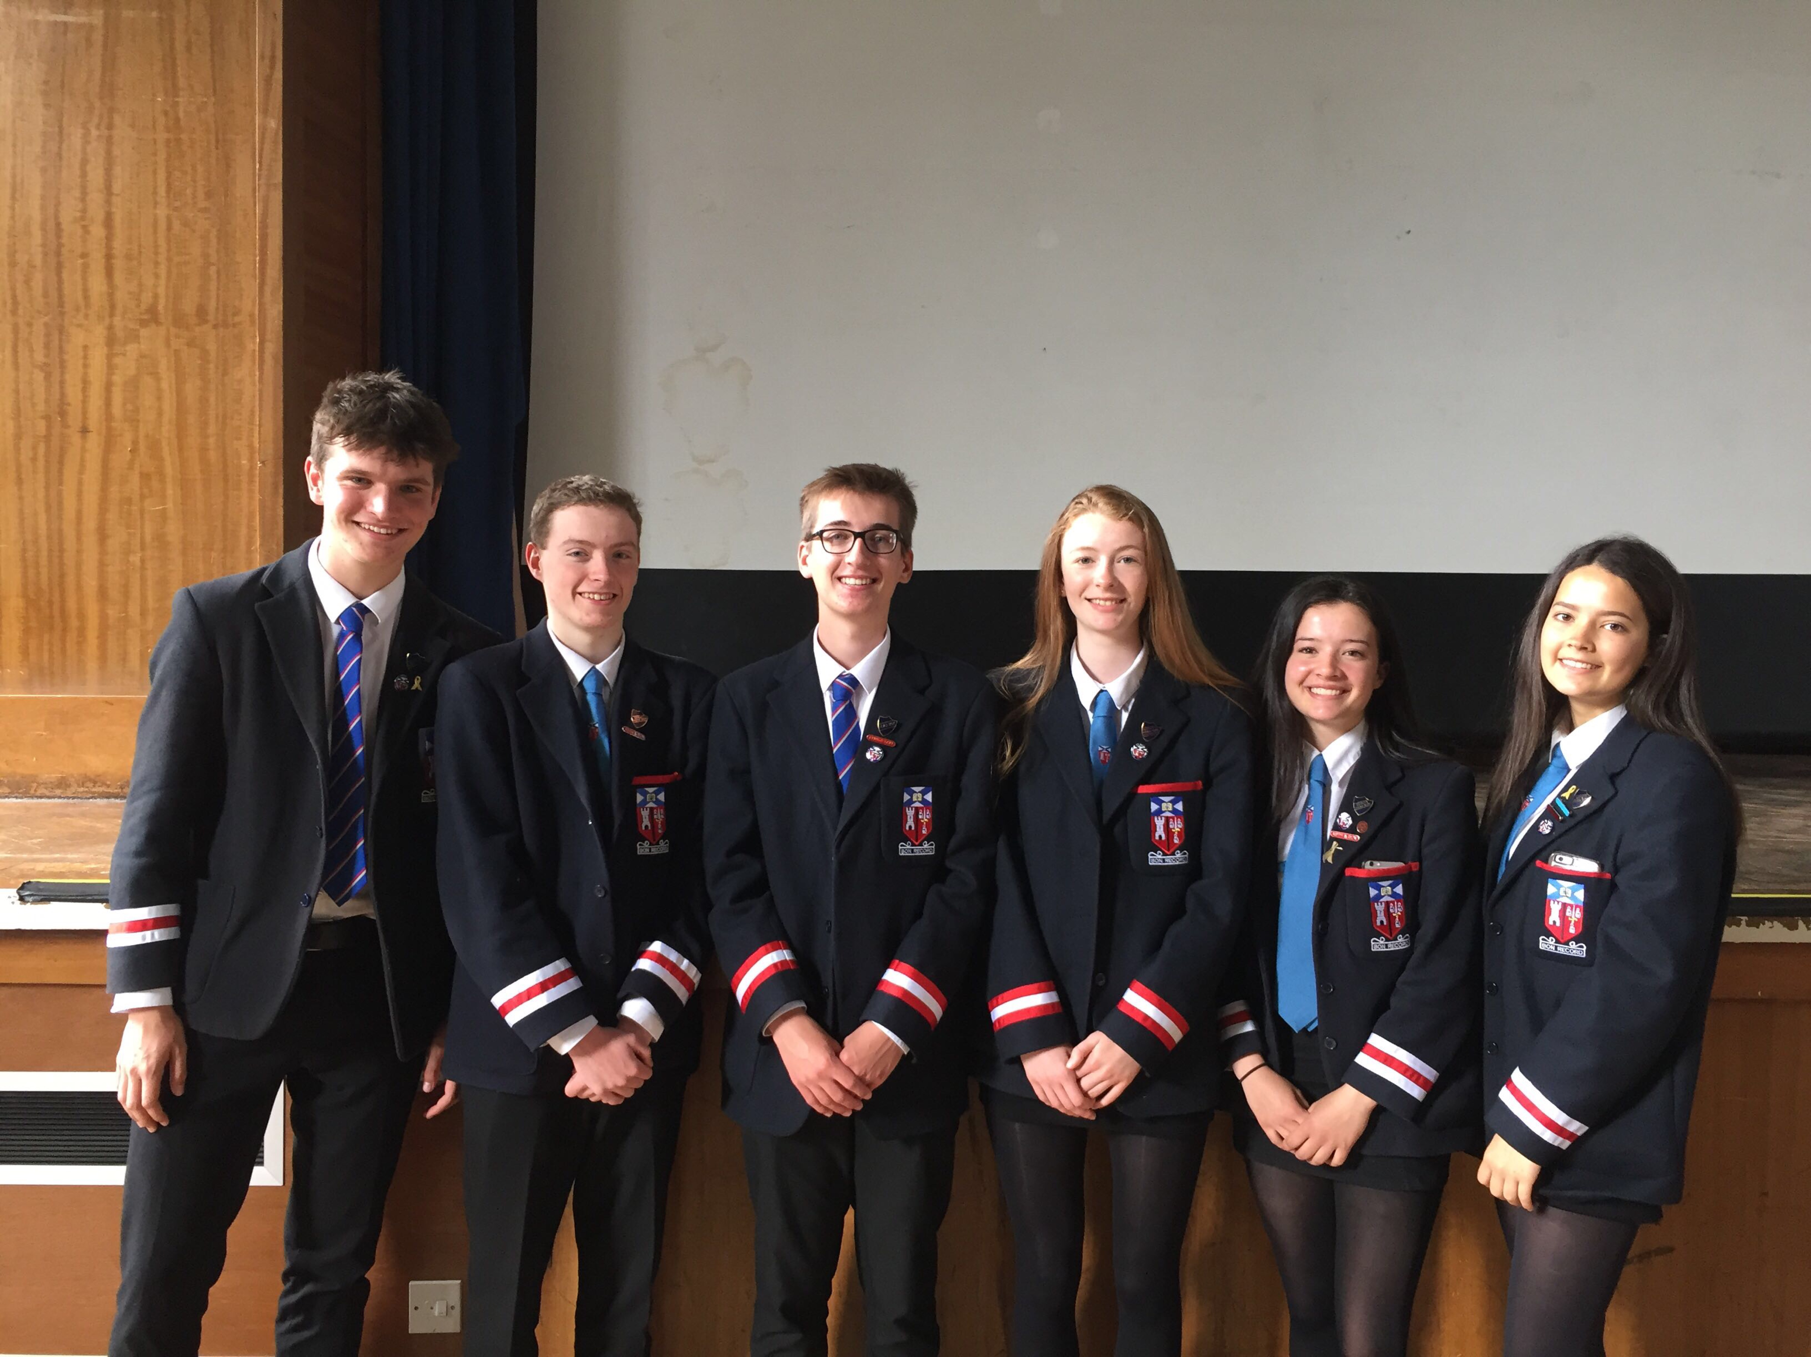
Senior Prefect Team
Head Boy
Lewis MacIver
Deputy Head Boy
Angus Hogg
Rory Ferguson
Head Girl
Catherine Denison
Deputy Head Girl
Deirdre O’Riordan
Jennifer Herrera

Slide 3
What is Pupil Council?
Pupil council allows pupils’ thoughts and opinions to be heard.
Through the use of surveys, open sessions and focus groups, pupils are able to voice their opinions on topics that impact everyone in the school.
The school is then able to include pupils when making decisions on crucial things that affect the entire school community.

Slide 4
Why it is changing?
As you may remember, the school used to have House Councils, however as many of you may know these were never very efficient and rarely got anything done.
Because of this, the Student Council system has been completely redesigned in order to best serve the school!

Slide 6
Why should I apply?
Working on the student house council can be incredibly rewarding. It allows pupils to have their opinions heard by the school.
It also allows pupils to develop their own skill sets, helping improve leadership skills while also allowing members to participate in a thriving team working together to make school life more enjoyable for everyone.

Slide 7
Criteria
To ensure we have the best team possible, applicants must meet the following criteria:
Reliable and responsible
Be capable of showing leadership and commitment to the life and work of the school
Willing to attend meetings during school
Able to bring new innovative ideas to the school

Slide 8
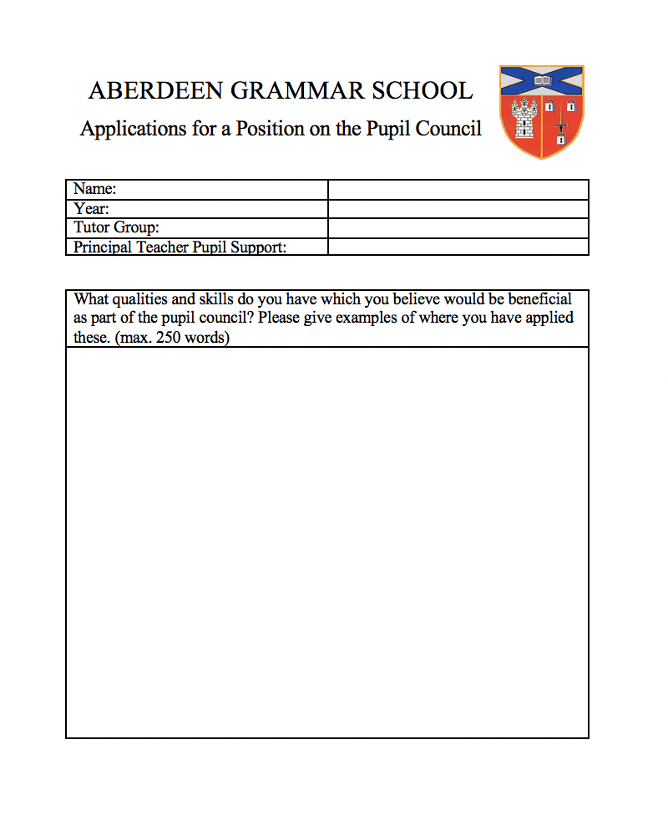
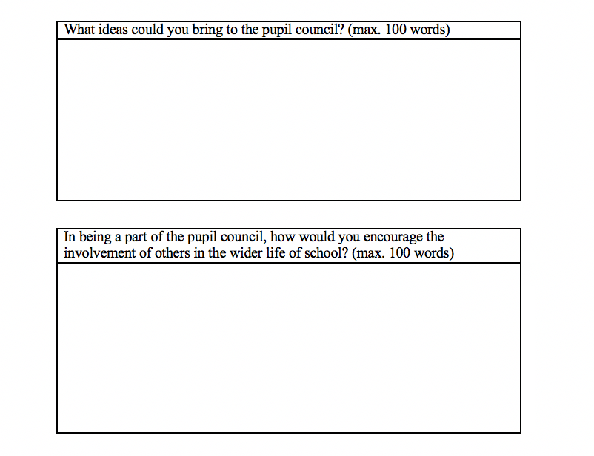
How can I apply?
To apply, you will need to fill out a short application form that can be found on the school website or collected from guidance
The application form must be handed into the office by Thursday 27th September
The top 6 applicants from each year will be successful
Don’t worry if you are not selected as there will be regular open sessions allowing anyone to come in and voice their opinions!

Slide 9
Thank You For Listening

