Slide 2


Welcome to our S1
Learner Pathways Evening
Developing the Young Workforce (DYW)

Slide 3
Purpose of the evening
Introduction – Alison Murison (Head Teacher)
Purpose of the Curriculum, CFE levels and National Qualifications – Alison Murison
Personalising the BGE – Alan Martin (DHT curriculum)
Skills Development Scotland – Mrs Morag Evans
MyWOW ambassadors – demonstrating website and skills

Slide 4
Purpose of the Curriculum
Health and Well-being
Languages (English, Modern Languages)
Expressive Arts
Mathematics
Sciences
Technologies
Social Studies
Religious and Moral Education

Slide 5
CfE levels and National Qualifications
In S1-S3, pupils are building their skills to
prepare for National Qualifications in S4-S6
SQA National Qualifications
Junior Phase S1-S3 | First level (1)
 | Second level (2)
 | Third level (3)
 | Fourth level (4)
National 4 (4) | Senior Phase S4-S6
National (5)
Higher (6)
Advanced Higher (7)

Slide 6
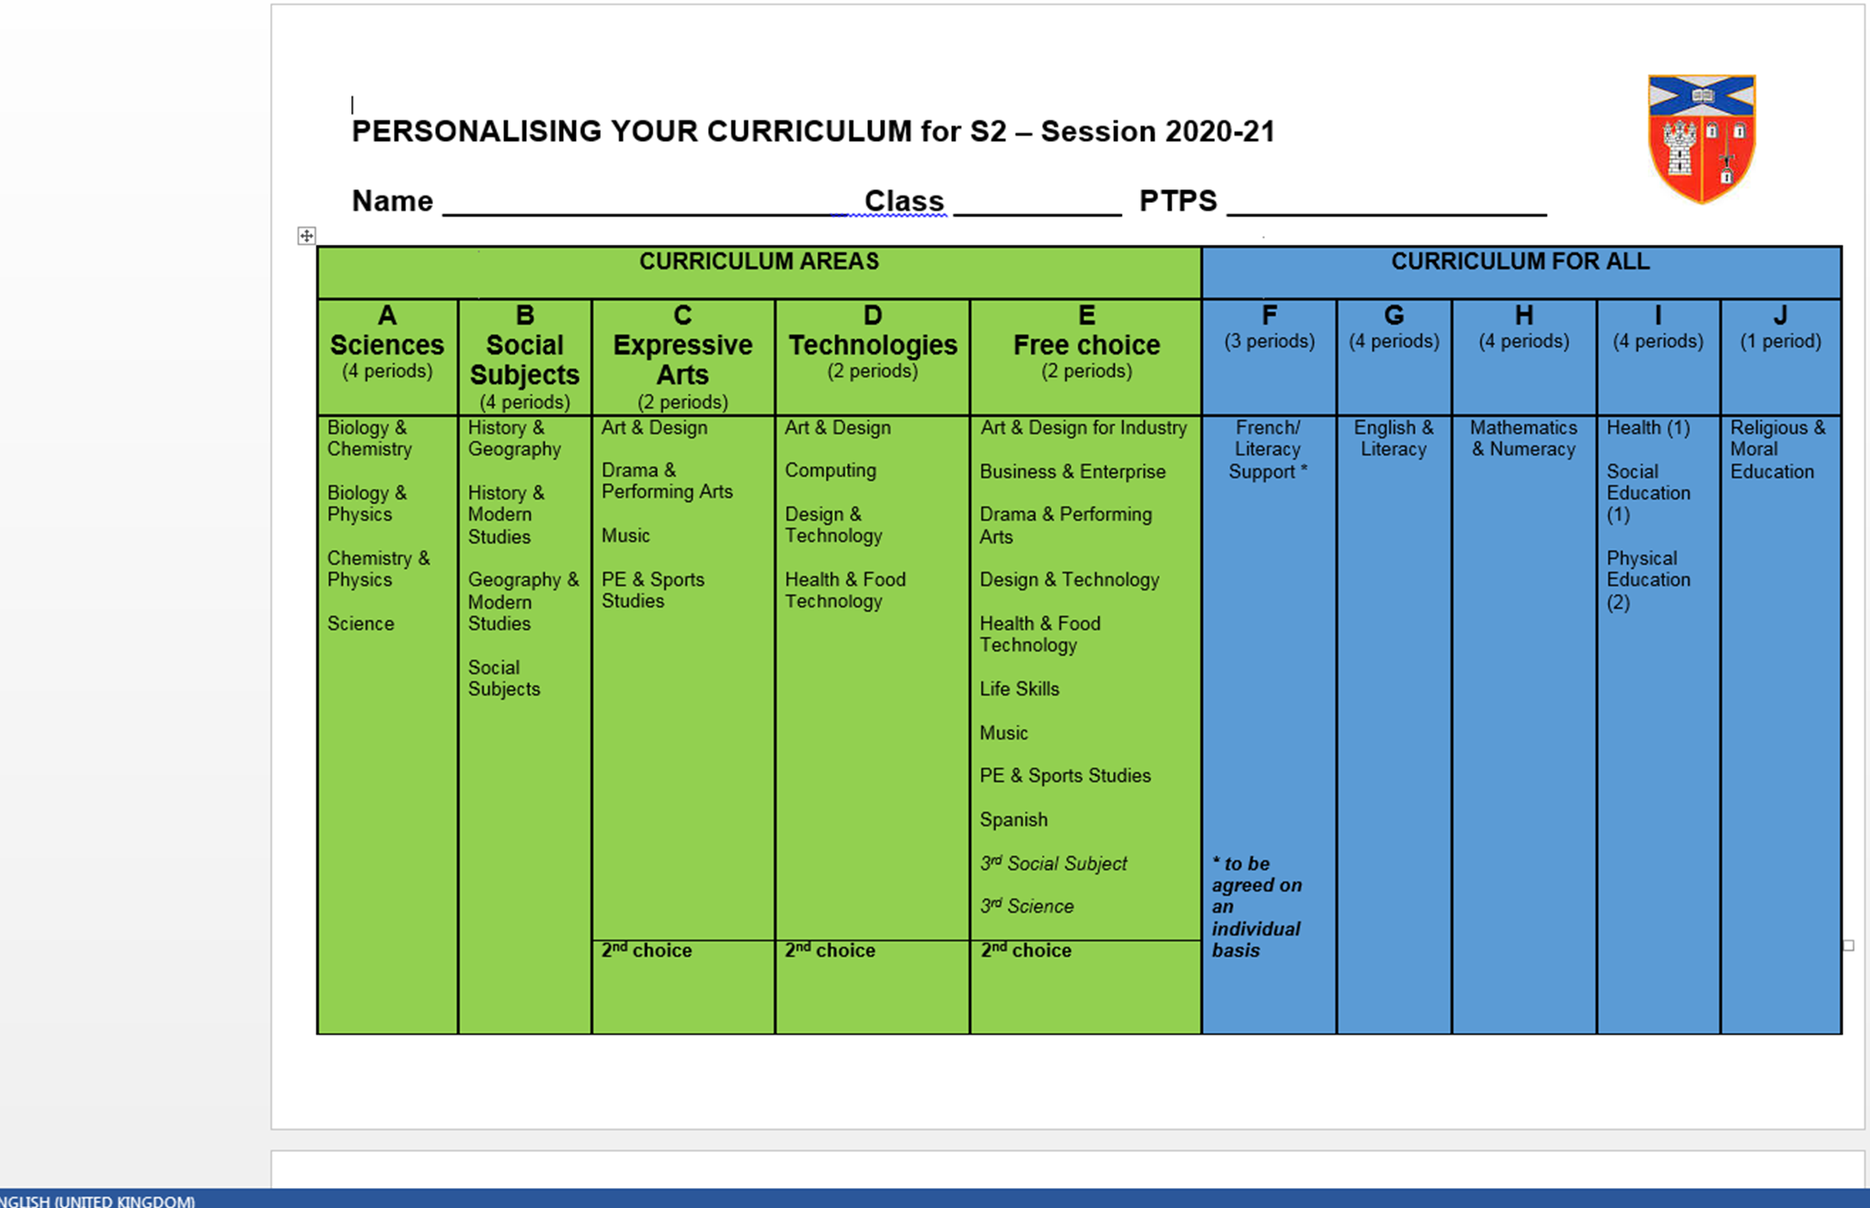
Notes:
Trial choices idea was gathered in SE last week
Explain purpose to cover the 8 curriculum areas with a degree of personalisation and choice embedded
Some learners may benefit from Science as a common course that covers experiences and outcomes on a more practical basis – this is the same for social subjects
French may not be the most appropriate for all learners and PTPS will discuss with pupils and parent/carers an alternative eg Literacy support
PTPS to be contacted if specific questions relating to course choice

Slide 7

Career Management Skills
www.youtube.com/watch?v=uDJu8O7Lxr8
Notes:
Alan to introduce CMS – Skills presentation that has been shown to S1 in November.
All S1 have now been discussing skills and are updating their skills profiles in ICT throughout the rest of the year.
All S1 have created a MYWOW account – usefiul resource that you can look at with your son/daughter.
Hand over to Morag

Slide 8

AGS Careers Service
Career Management Skills
not just about specific job titles, but skills, strengths and future opportunities
encourage pupils to study what they are enjoying and are doing well in
2nd ½ of lunch break Mon & Thurs
www.myworldofwork.co.uk www.mykidscareer.com
www.planitplus.net

Slide 9

The Future
The way we work is about
to change forever
The future has already begun

Slide 10

Bad robots won’t steal our jobs!

Slide 11



Skills for the Future
Higher Order or Meta Skills
THINKING SKILLS
Adapting
SOCIAL SKILLS
communication
INNOVATION
Curiosity
active learning
social perceptiveness
Team work
Focusing
Self management
Creativity
Sense Making
Judgement & decision making
Leadership
Notes:
Audience: young people, parents, education partners.
Key Message: We know that the future will require a workforce with a wide range of skills, abilities and knowledge including a mix of strong social skills, thinking skills and the ability to self manage in order to adapt and pick up additional skills through-out life. These skills will need to be supported by a broad, transferable knowledge base (subject such as English, administration & management, social subjects, foreign languages, STEM, digital and design knowledge).
Our young people need opportunities to develop these skills and to test and apply them in different settings, including the work-place.
Sources: Skills 4.0: A Skills Model to drive Scotland’s Future, SDS and Centre for Work Based Learning in Scotland (Feb 2018). The broad knowledge base is from The Future of Skills: Employment in 2030, NESTA, Pearson's group, Oxford Martin School (Sept 2017)
FYI: Some of the skills terminology used within the Skills 4.0 model and Future Skills reports have been adapted to be more accessible to a wider audience.
Original terminology includes: cognitive skills, higher order skills and meta-skills, social intelligence, systems skills (understanding how humans and technology relate), digital-human feedback loops, systems analysis. Feel free to use the original terminology if it is more appropriate to your audience.

Slide 12













Key Sectors
Growth Sectors
Health & Social Care
Finance & Business Services
Tourism
Construction
Engineering
Food & Drink
Energy
Creative Industries
ICT / Digital
Life Science
Chemical Science
Notes:
Audience: younger customers
Context : Key Sectors are those selected by the Scottish government as having the potential to grow making Scotland more economically competitive and which they support both through financial investment and by creating more opportunities to study and work in these areas (additional college, university and apprenticeship routes)
What this means for customers: this creates more and better opportunities for people working or starting a business in Scotland (better paid, more job opportunities, opportunities at higher professional levels and opportunities for progression)
What is needed: in order to grow these sectors needs to right elements, one of the key needs is a supply of people with the right skills and qualifications and ongoing upskilling and future focused leadership within the sectors. If there is an issue with this supply it can mean the sector cannot grow – this is why they may be a growth sector but may also show forecast decline on the Industry Sector Forecast slide.

Slide 13
MYWoW
Ambassadors
Deidra Dias-Alberto
Anusuya Bohara
https://docs.google.com/presentation/d/1CsDPevTUfy5Cv4kzEF2MUmwus-zO9OD60ELaRS2TH0c/edit#slide=id.p

Slide 14
Next Steps
Depute presentation to S1’s – Week beginning 24th February
Course booklets and choice form issued via Google forms 24th February
Parents night: Wednesday 11th March
Choice form returned: Friday 20th March

